Slide 1
Java Advance UnitTesting
& JUnit, TDD and TestNG
AnhPham
Sep 14

Slide 2
Agenda
Day 1
Basic UnitTesting, JUnit, setup, annotation, assert, execution order
Day 2
Junit Testing, parameters, procedures, rules, categories. TDD, DTDD, ATDD
Day 3
Junit Testing, refactoring, anti-patterns, automation keyword. Mockito
Day 4
Jprofiler UnitTesting: check mem, cpu. Counting called, be-called. End course exam.

Slide 3
Needed skills
Good at Java OOP
Know Java JUnit

Slide 4
Focus
Design and training how to implement advance JUnit test with Eclipse
Work with JUnit patterns, anti-patterns
Mock, Stub
Running test with Eclipse JUnit, coverage with Eclipse addins EclEmma
Design and training how to implement advance TDD test patterns
TDD patterns
Design and training how to implement JUnit with integration test
Some strategies in refactoring
Report the test

Slide 5
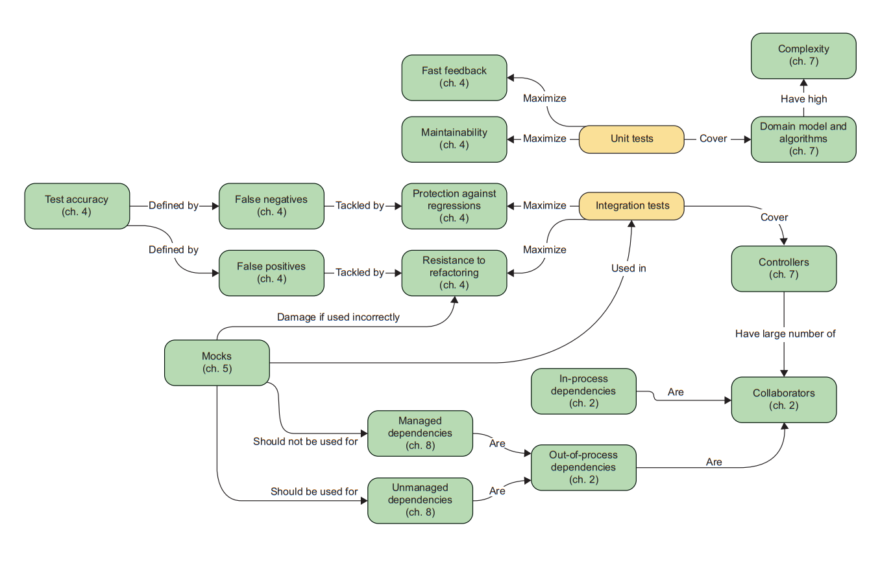

Slide 6
NOT Focus
How to run/build/deploy... Unit Test on CI, gradle, mvn, ant… or specific server
How to config server, config network, do devops
Optimize Java programming
Optimize refactoring
Optimize automation test
How to design new test automation framework

Slide 7
4 pillars for good unittest
Protection against regressions
To maximize the metric of protection against regressions, the test needs
to aim at exercising as much code as possible.
Resistance to refactoring
Tests provide an early warning when you break existing functionality
You become confident that your code changes won’t lead to regressions
Fast feedback
How hard it is to understand the test
How hard it is to run the test
Maintainability
Num of reused testcase

Slide 8
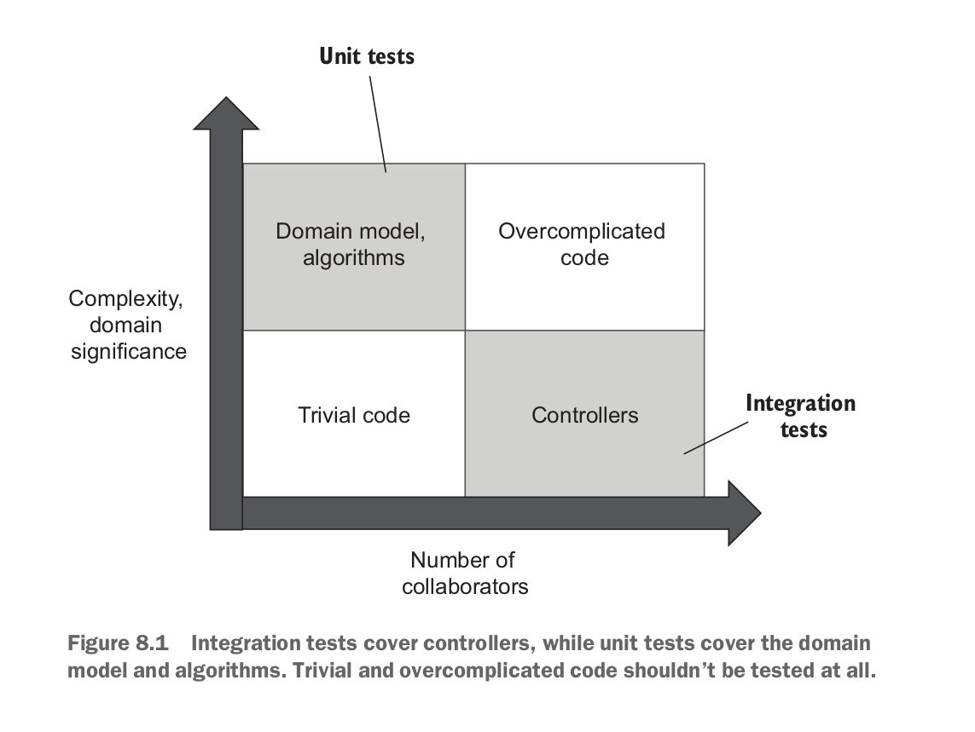
Scope

Slide 9
Day 1

Slide 10
Review skill !!!

Slide 11
Agenda
Setup and Scope
UnitTest process, plan, doc
OOP code quality
Common practices, JUnit best practices
Coverage

Slide 12
JUnit: setup, eclipse, cmd
Thực hành
Setup Eclipse
https://www.eclipse.org/downloads/packages/installer
Setup JUnit, EasyMockito, Spring library
JUnit 4.2, JUnit 5, EasyMock, Spring framework
Setup TestNG library
https://testng.org/doc/eclipse.html#eclipse-installation
Setup JProfiler
https://www.ej-technologies.com/download/jprofiler/files
Most reference:
https://junit.org/junit4/index.html (Junit 5: https://junit.org/junit5/docs/current/user-guide/#writing-tests )
https://www.manning.com/books/test-driven
https://www.wideskills.com/junit/junit-tests
https://www.codeproject.com/Articles/5772/Advanced-Unit-Test-Part-V-Unit-Test-Patterns
Import project to Eclipse
Add build path

Slide 13
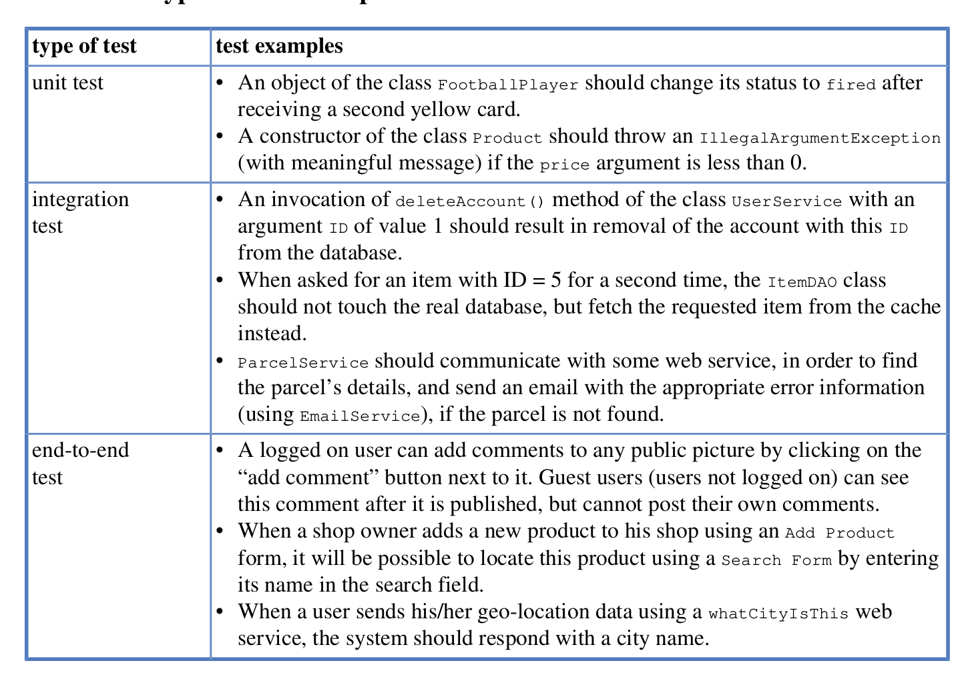
Scope

Slide 14
JUnit: setup, eclipse, cmd
Thực hành
What function?
What to test?
How?
Practice: annotations

Slide 15
Kết luận quan trọng #1

Slide 16
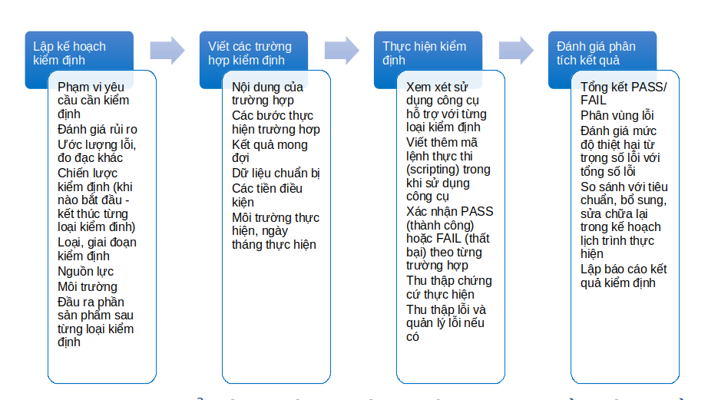
UnitTest Process

Slide 17
4 pillars for good unittest
Protection against regressions
To maximize the metric of protection against regressions, the test needs
to aim at exercising as much code as possible.
Resistance to refactoring
Tests provide an early warning when you break existing functionality
You become confident that your code changes won’t lead to regressions
Fast feedback
How hard it is to understand the test
How hard it is to run the test
Maintainability
Num of reused testcase

Slide 18
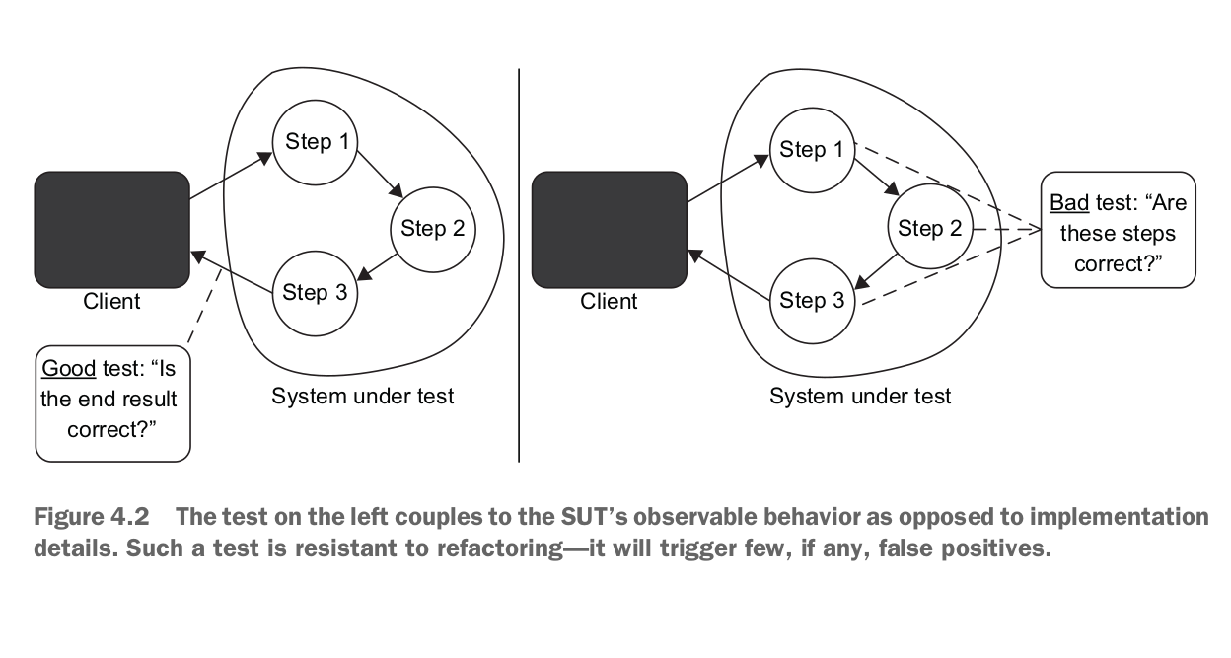

Slide 19
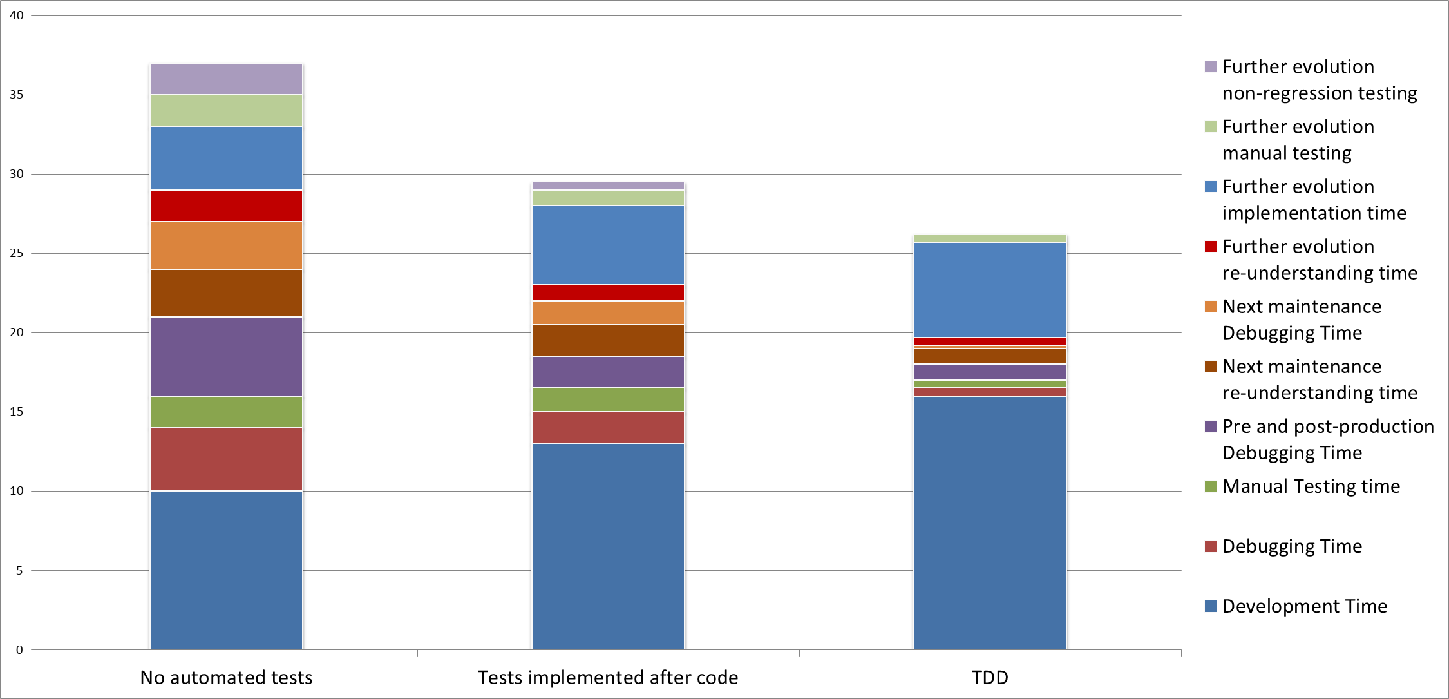

Slide 20
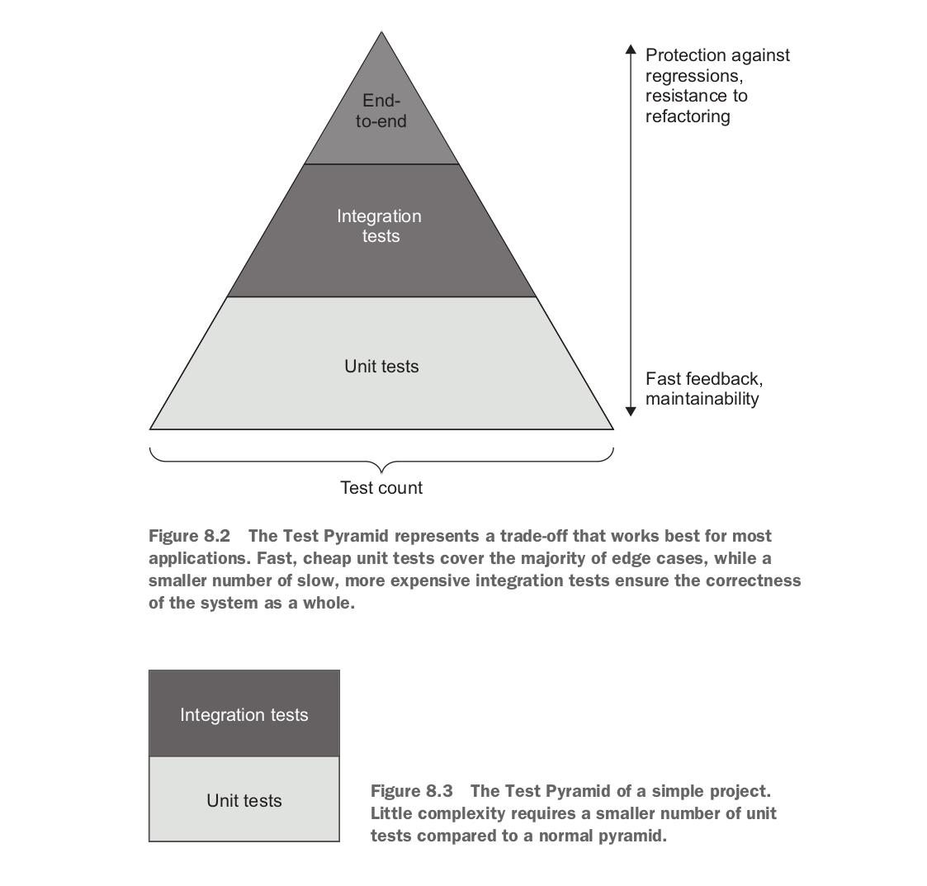
Test pyramid

Slide 21
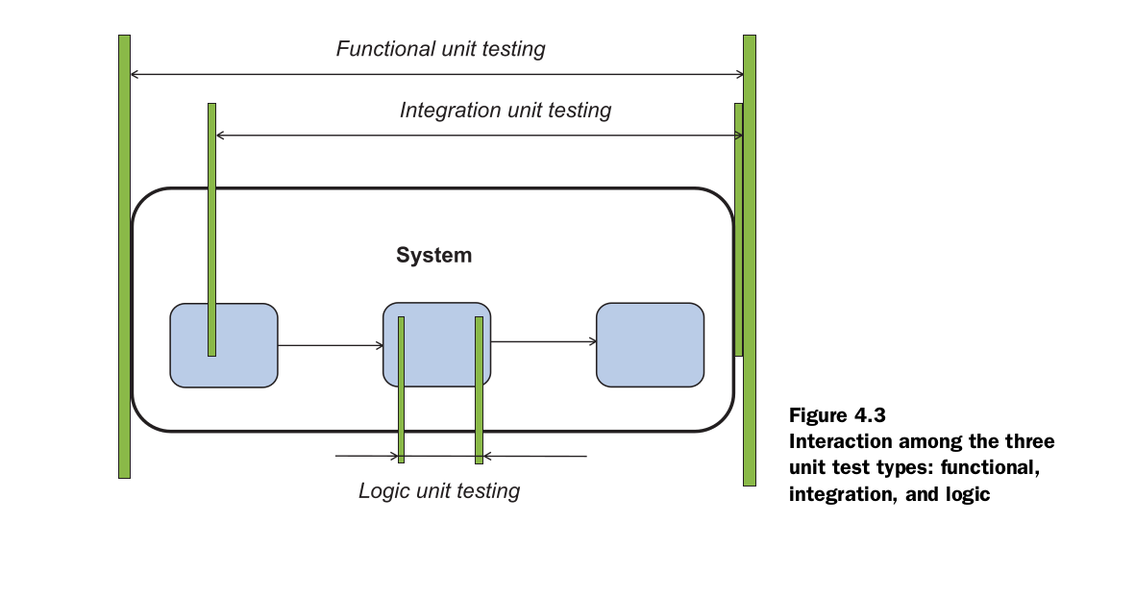

Slide 22
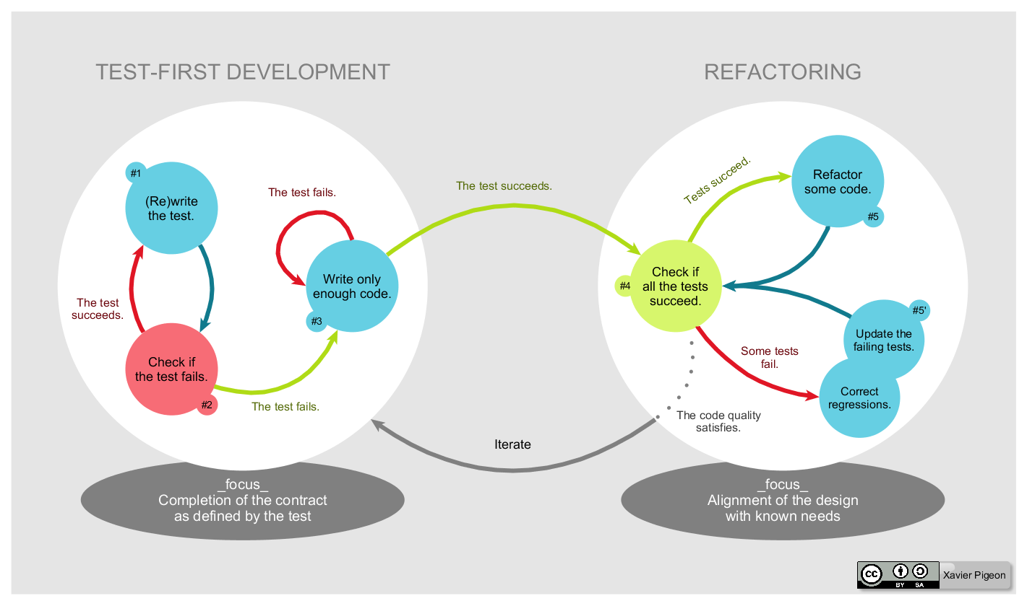

Slide 23
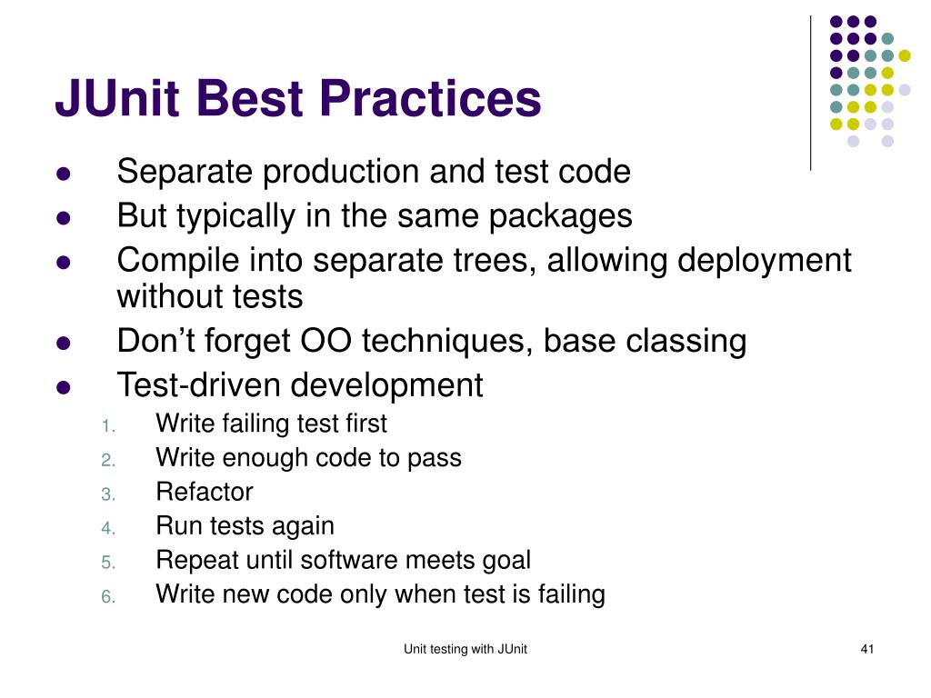
Common
practices

Slide 24
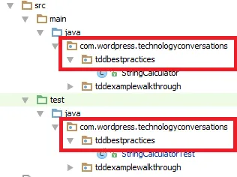
JUnit best practices
Naming Conventions
Processes
Development practices
Pass/Fail Patterns
Arrange, Act, Assert
Data Transaction Patterns
Collection Management Patterns
Performance Patterns
Process Patterns
Simulation Patterns
Multithreading Patterns
Stress-Test Patterns
Presentation Layer Patterns

Slide 25
A unit test is a piece of a code (usually a method) that invokes another piece of code and checks the correctness of some assumptions afterward
A unit is a method or function.
When JUnit?
Its purpose is to be a basis for the creation of test automation code
When TDD?
With the use of TDD, the code design is defined in cycles. The idea is that with each new test added, a small increment of functionality is made compared to the previous version

Slide 26
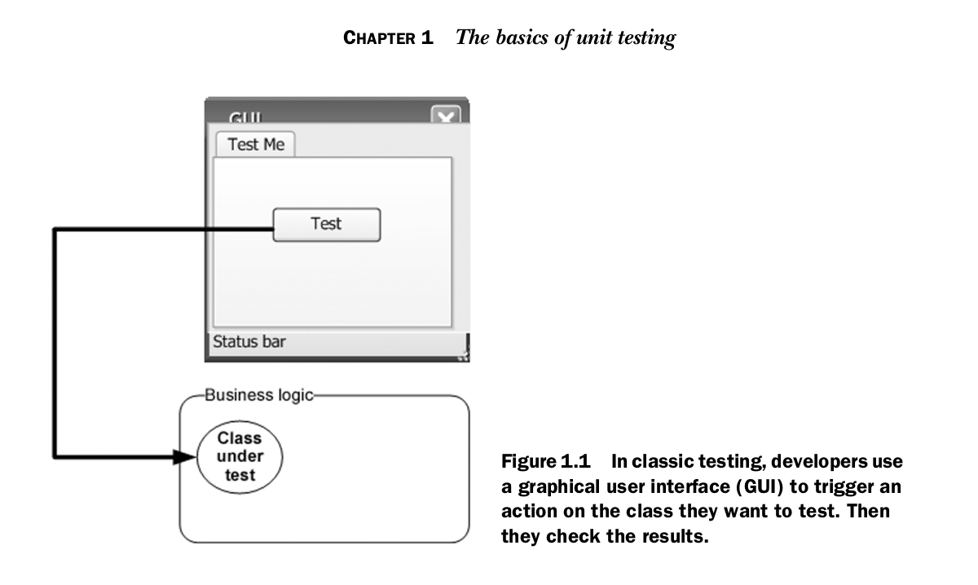
Basic

Slide 27
Basic 8
Be automated and repeatable.
Be easy to implement.
Be relevant tomorrow.
Run quickly.
Be consistent in its results (it always returns the same).
Have full control all units
Runs independently
When it fails, be easy to detect things expected and pinpoint the problem.

Slide 28
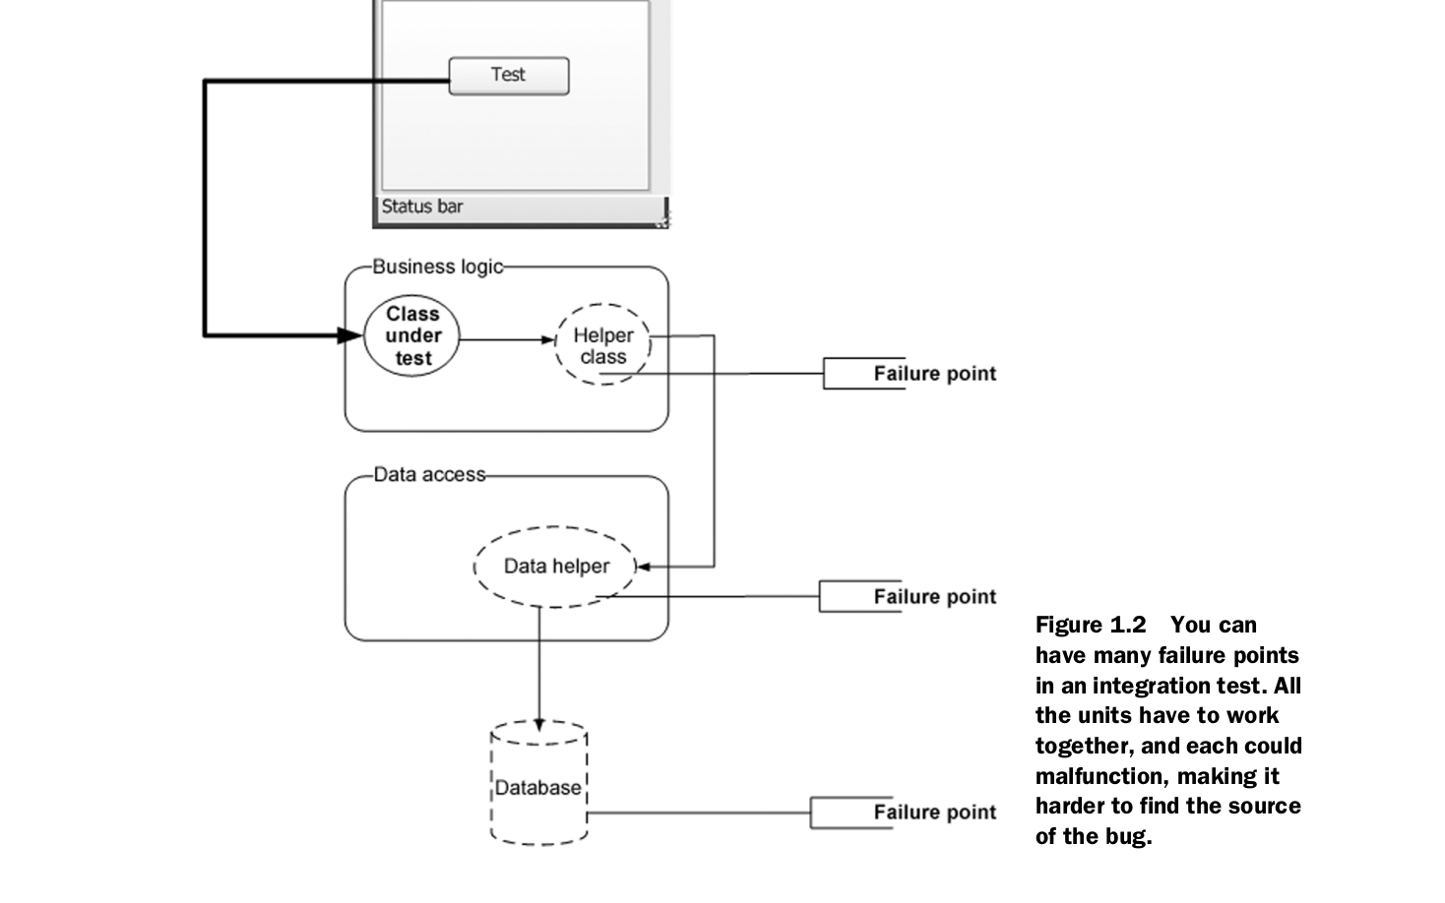
Failure

Slide 29
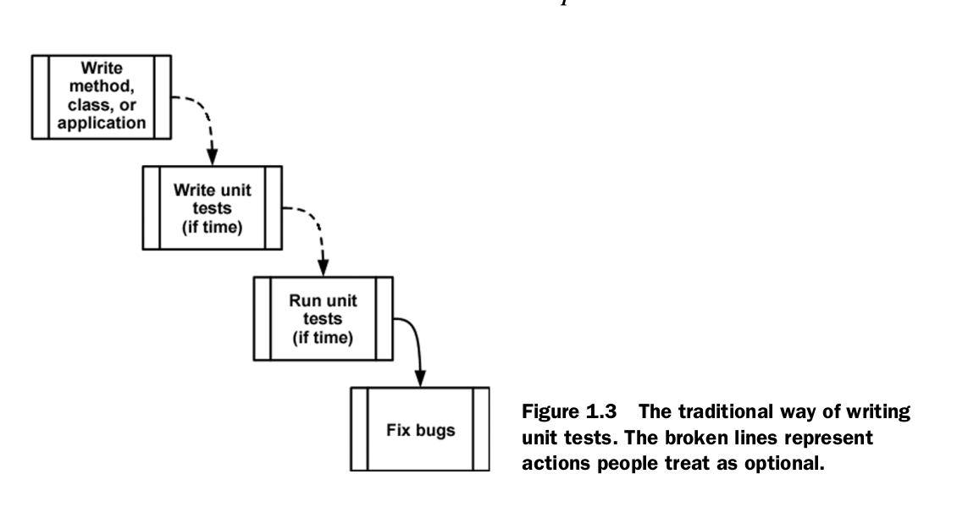
Classical

Slide 30
Try a classical test!

Slide 31
Steps 4 classical
Application & app sourcecode should avail
Requirement usecase should be clear
Design some testcase
Write test sourcecode separatedly
Run test coverage
Report bugs from app sourcecode
Report test progress

Slide 32
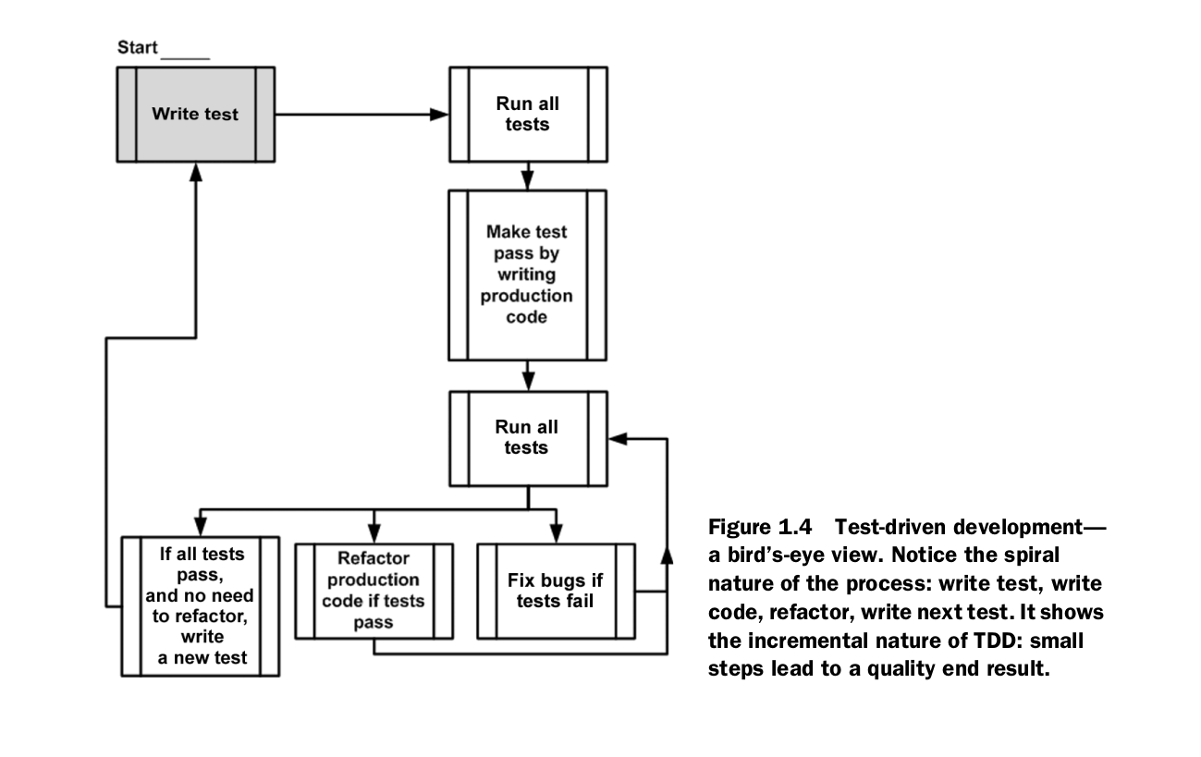
Test-driven

Slide 33
Try a TDD test!

Slide 34
Steps 4 TDD
Requirement usecase should be clear
Design some testcase
Design layout/skeleton of app sourcecode
Write test sourcecode separatedly with faked app sourcecode
Write app sourcecode
Run test sourcecode
Refactor app sourcecode
Run test coverage
Report test progress

Slide 35
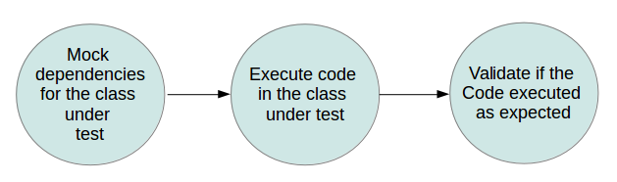
Mock

Slide 36
Stubs n Mocks
A stub is a piece of code that’s inserted at runtime in place of the real code, in order to isolate the caller from the real implementation. The intent is to replace a complex behavior with a simpler one that allows independent testing of some part of the real code.
Mock objects replace the objects with which your methods under test collaborate, offering a layer of isolation, don’t implement any logic: they’re empty shells that provide methods to let the tests control the behavior of all methods of the faked class.

Slide 37
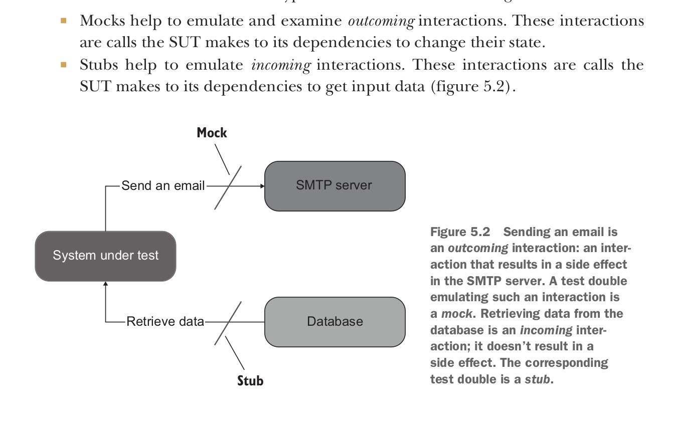

Slide 38
Try a Mock test!

Slide 39
Steps 4 Mock
Application & app sourcecode
If avail: create faked module
If not avail: design layout module
Design some testcase
Write test sourcecode separatedly
Run test coverage
Report bugs from app sourcecode
Report test progress

Slide 40
Try a Stub test!

Slide 41
Steps 4 Stub
Application & app sourcecode
If avail: create faked module
If not avail: design layout module
Design some testcase
Write test sourcecode separatedly
Run test coverage
Report bugs from app sourcecode
Report test progress

Slide 42
Test-driven
Write a failing test to prove code or functionality is missing from the end product
Make the test pass by writing production code that meets the expectations of your test
Refactor your code (changing a piece of code without changing its functionality)

Slide 43
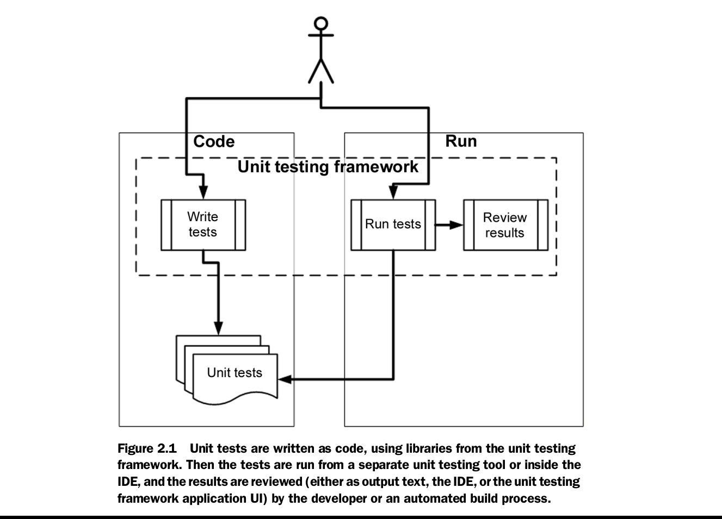
UnitTest
Framework

Slide 44
UnitTest Framework
Framework supplies the developer with a class library that contains
Base classes or interfaces to inherit
Attributes to place in your code to note which of your methods are tests
Assertion classes that have special assertion methods you invoke to verify your code
Framework provides a test runner (a console or GUI tool) that
Identifies tests in your code
Runs tests automatically
Indicates status while running
Can be automated by the command line

Slide 45
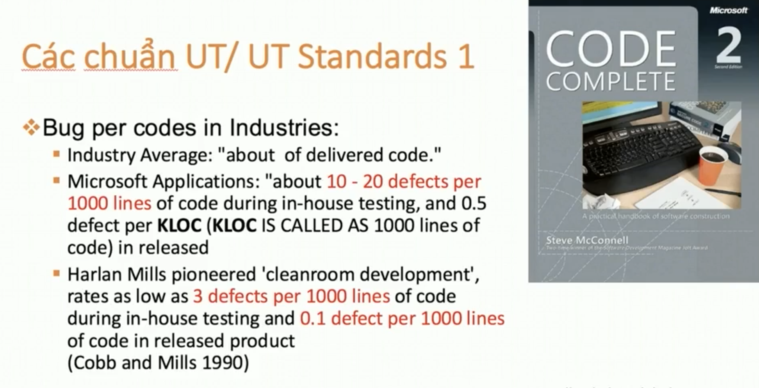
Kết luận quan trọng #1

Slide 46
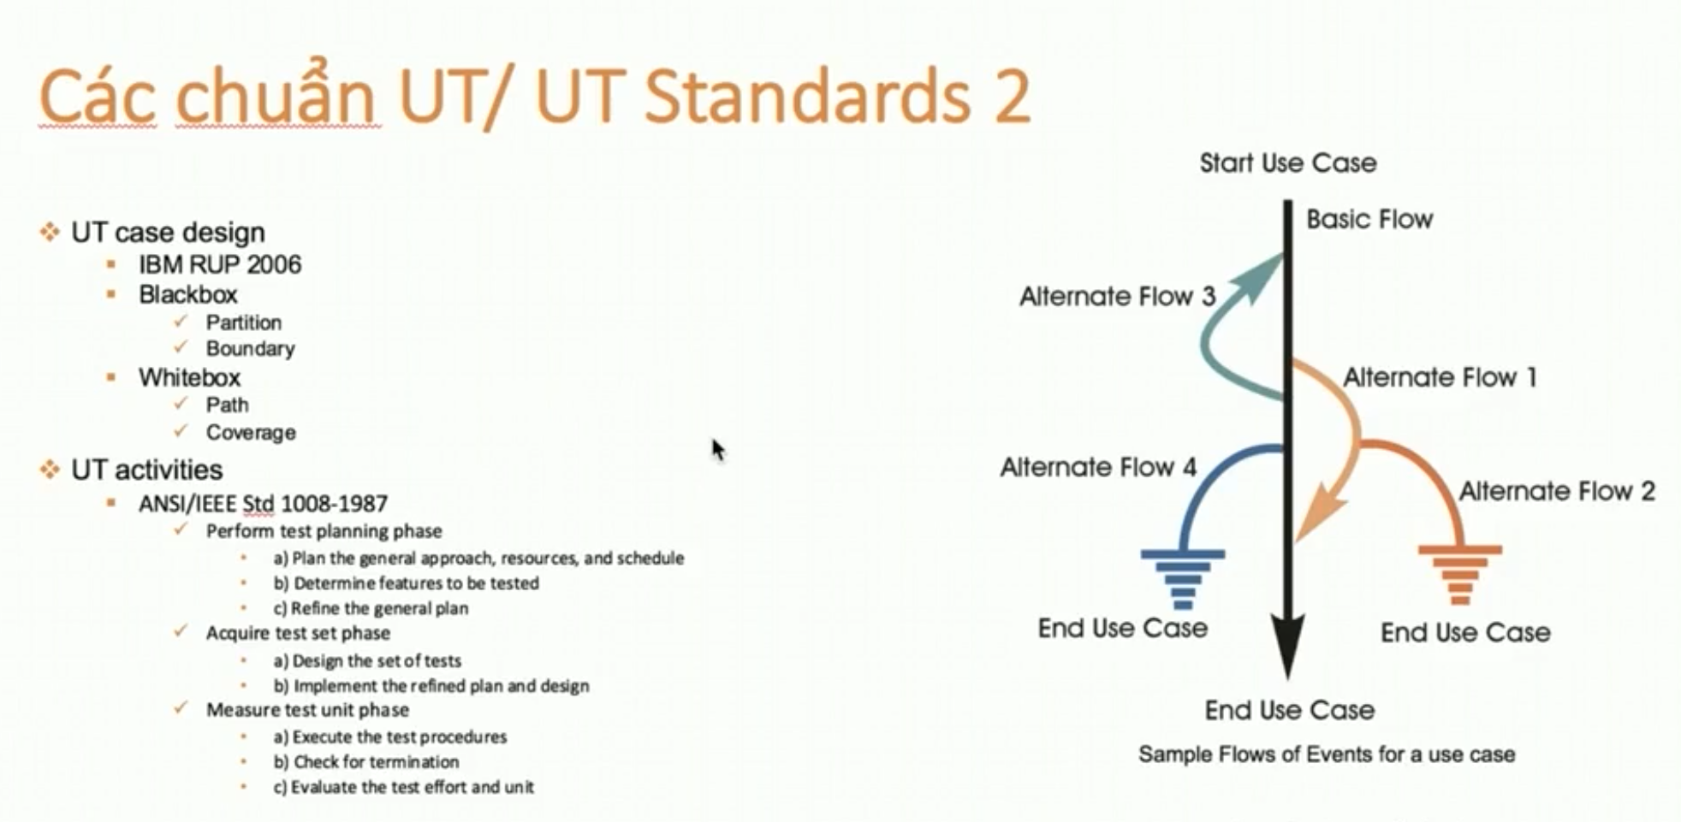
Kết luận quan trọng #1

Slide 47
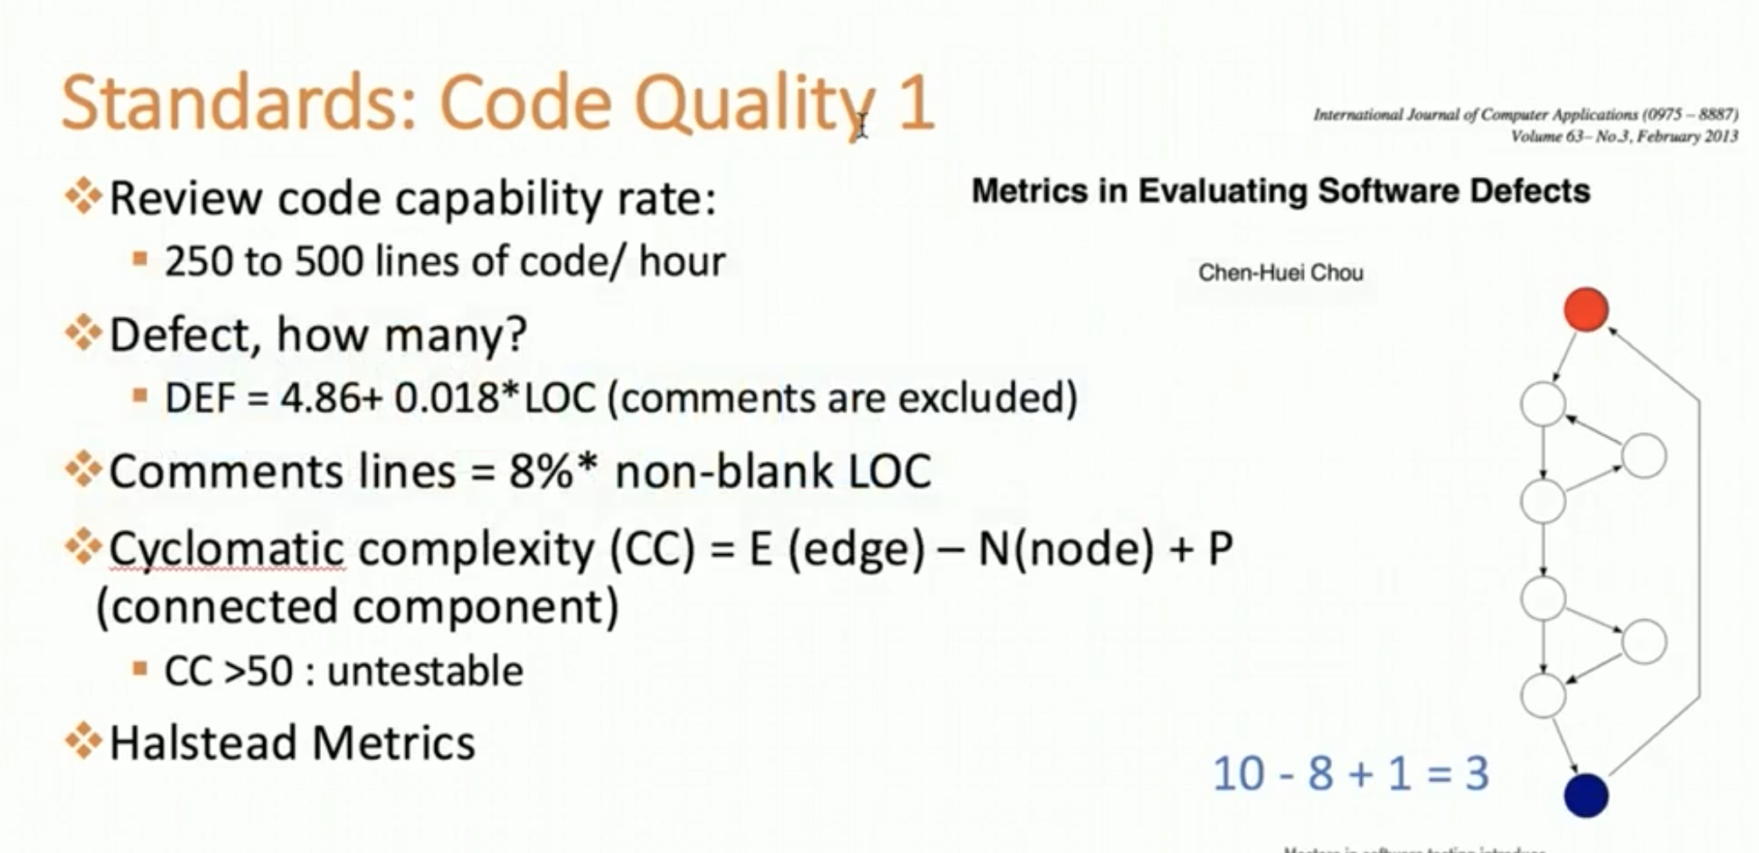

Slide 48
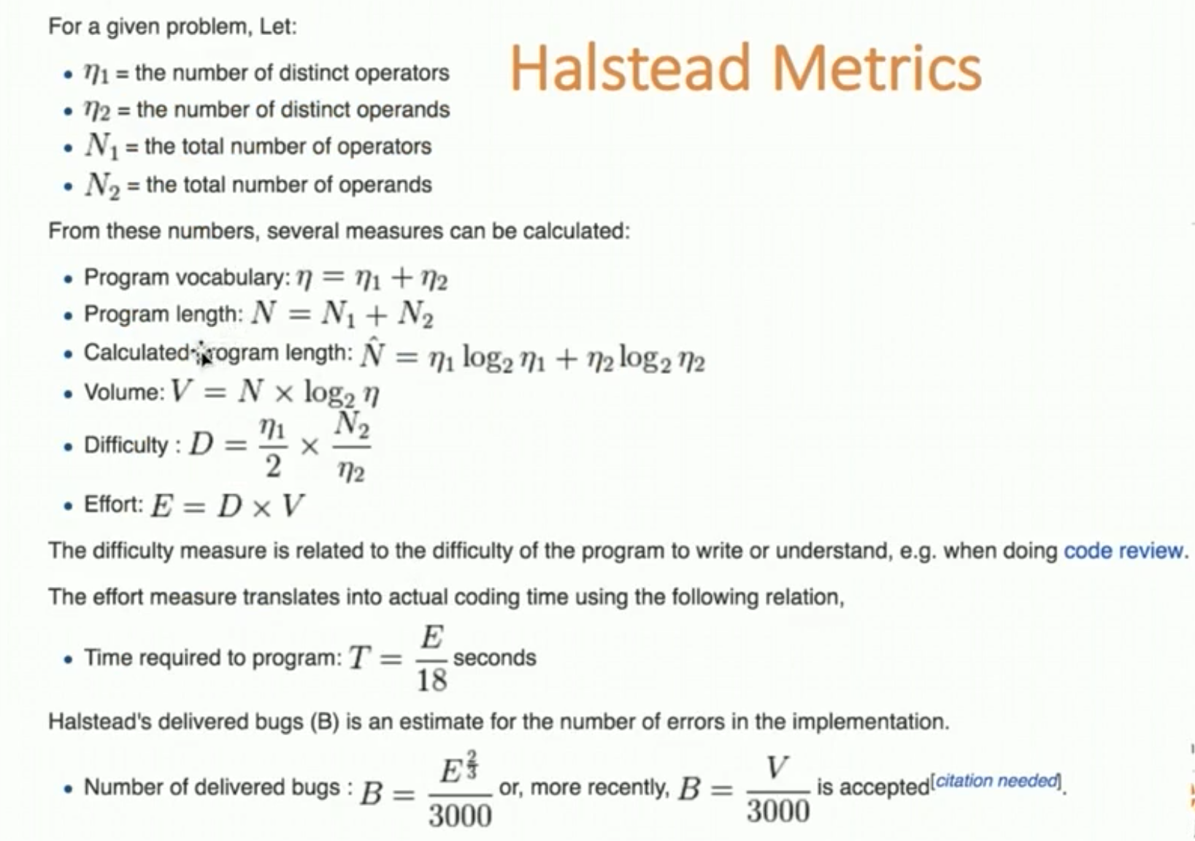

Slide 49
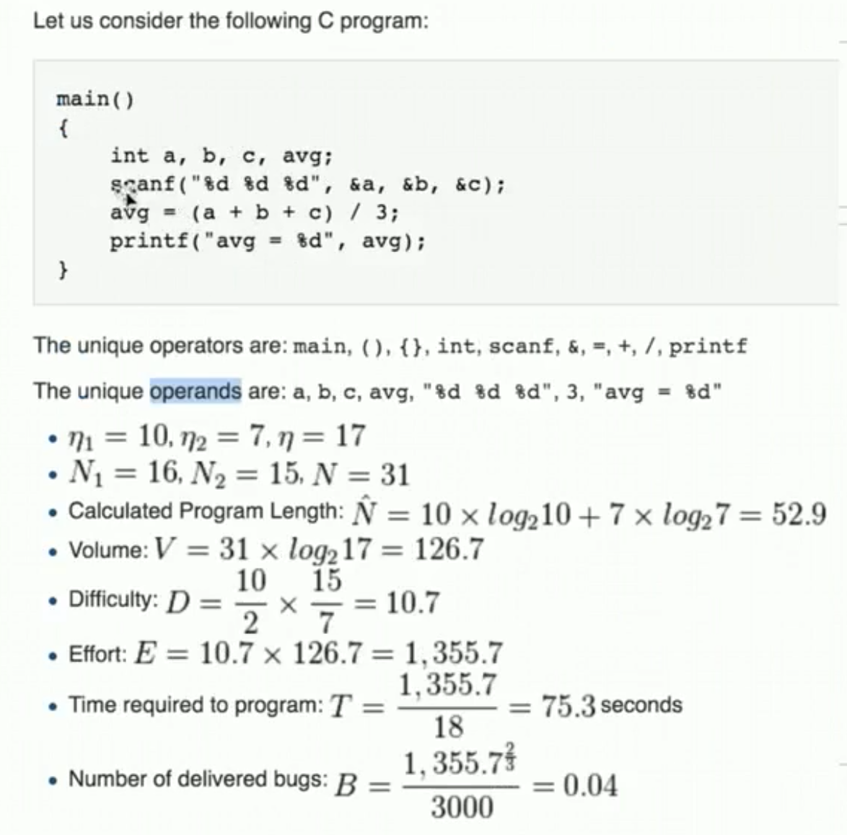
Example

Slide 50
JUnit: setup, eclipse, cmd
Thực hành
Practice: execution procedures
Assertions
Test Runners
Aggregating tests in Suites
Test Execution Order
Exception Testing
Practice: first TDD

Slide 51
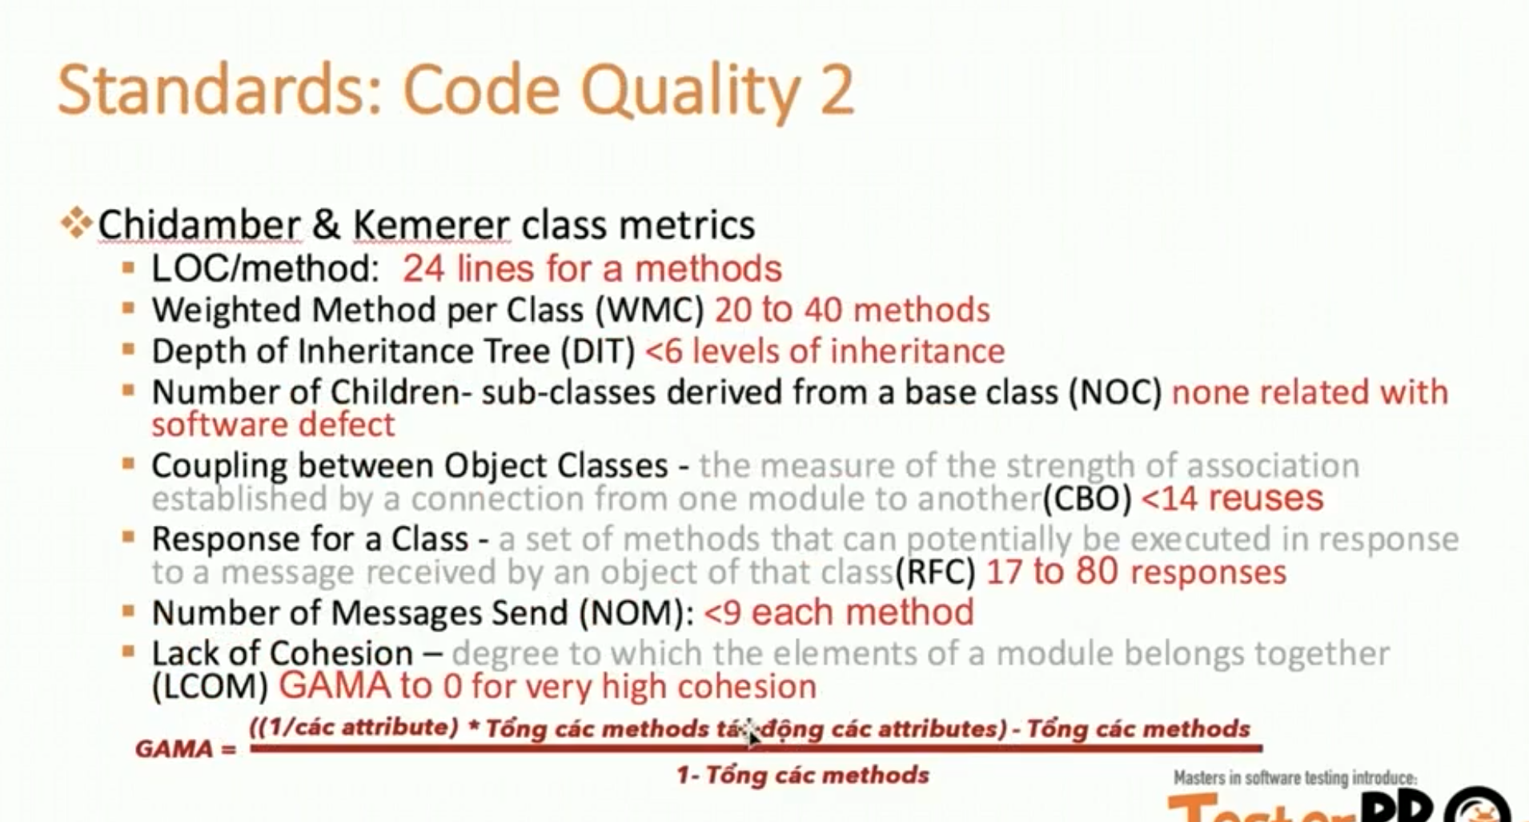

Slide 52
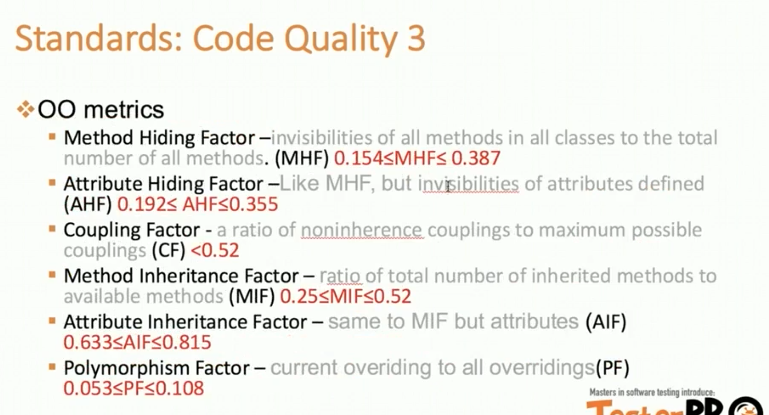

Slide 53
Kết luận quan trọng #2

Slide 54
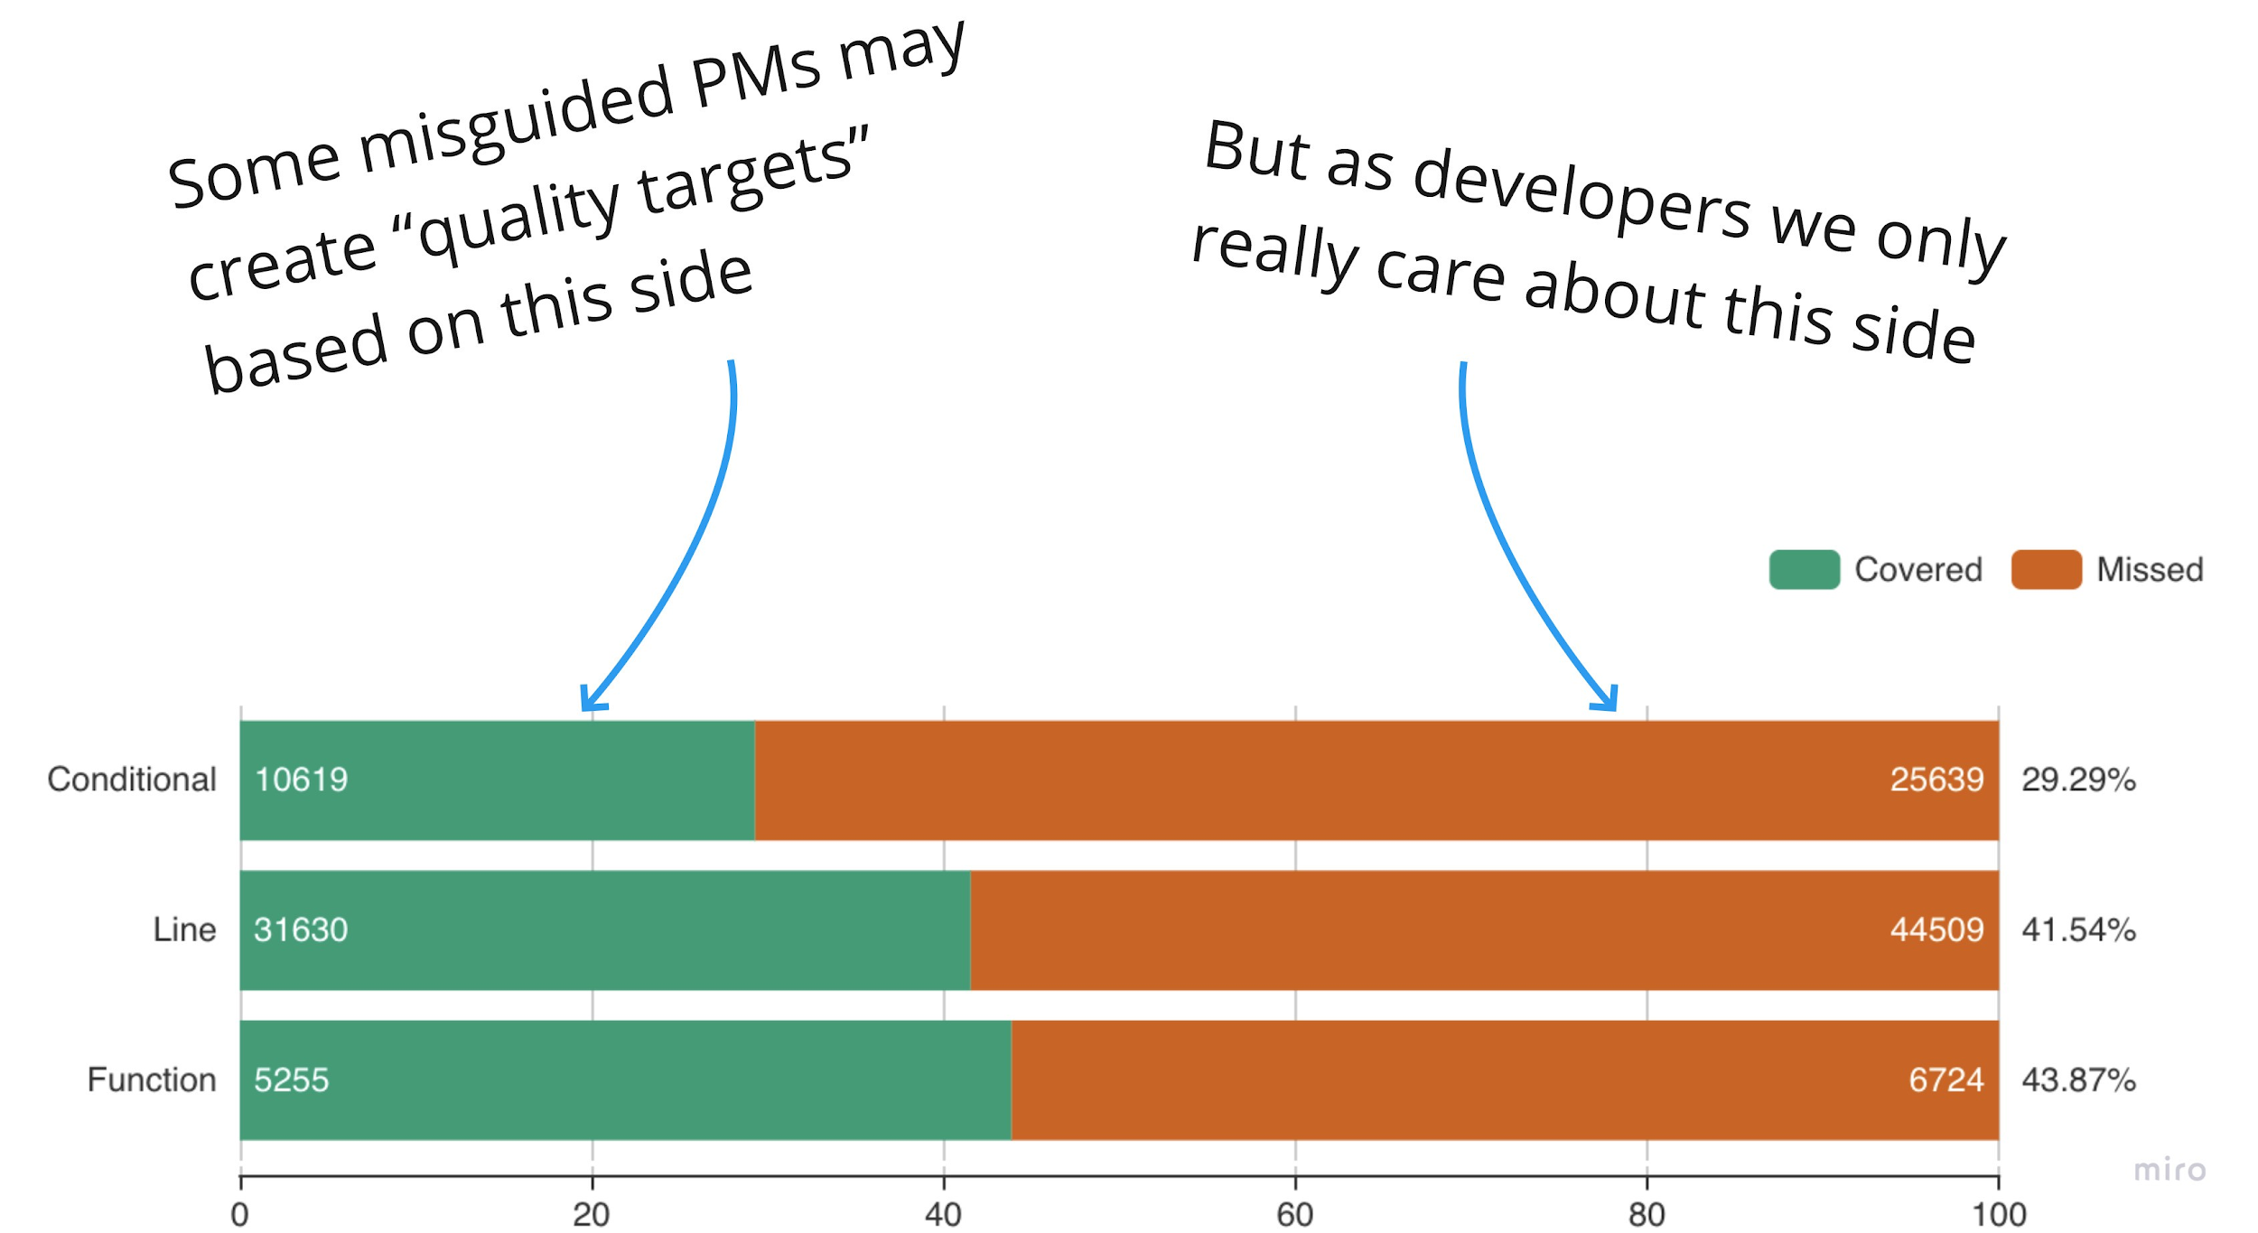
Coverage

Slide 55
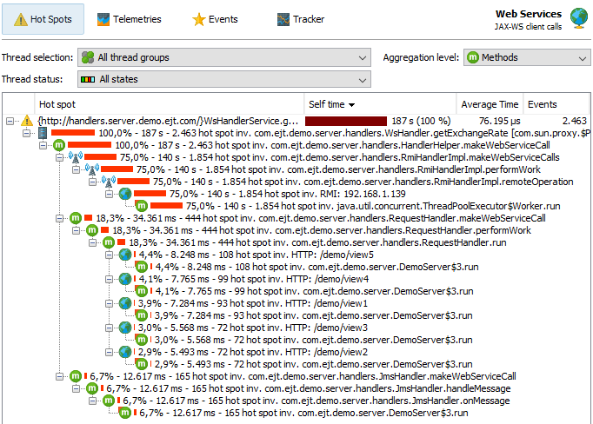
Code Quality with JProfiler
https://www.ej-technologies.com/products/jprofiler/overview.html

Slide 56
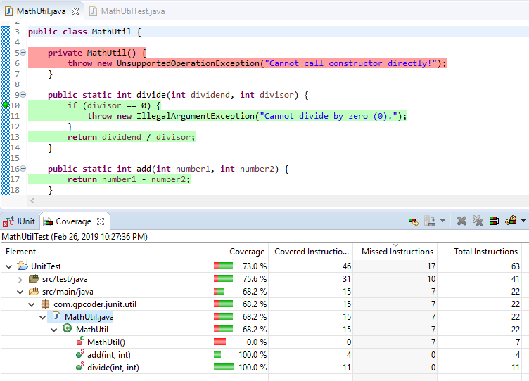
Java Unittest & EclEmma

Slide 57
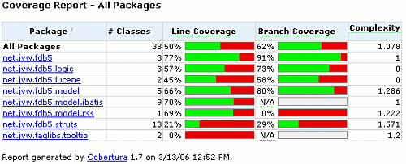
Java Unittest & Cobertura
https://www.baeldung.com/cobertura

Slide 58
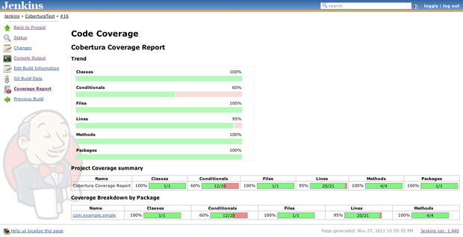
Java Unittest & Cobertura & Jenkin
https://www.loggly.com/blog/java-code-coverage-with-cobertura-and-jenkins/

Slide 59
Review test plan, ut testcases

Slide 60
JUnit: setup, eclipse, cmd
Thực hành
Practice
Exception Testing
Matchers and assertThat
Ignoring Tests
Timeout for Tests
Practice: first TDD
Practice: first automation

Slide 61
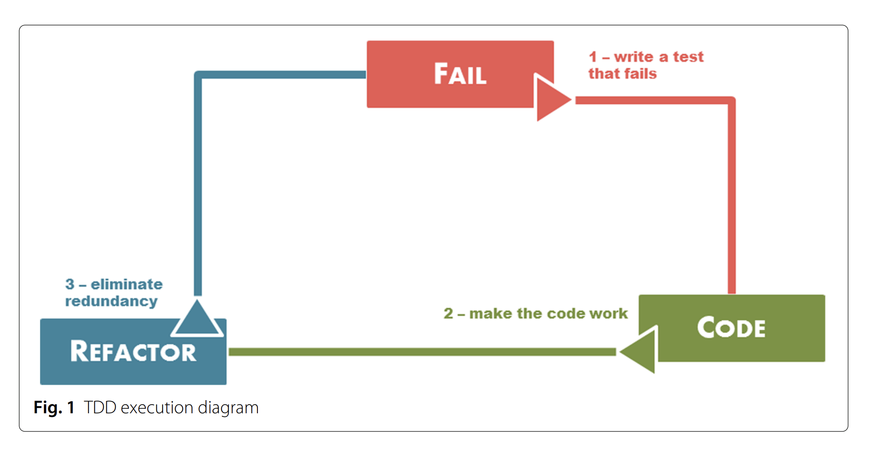
TDD process
1. Write the test case
2. Execute the test case and verify that it fails as expected
3. Implement code that makes the test case passes
4. Refactor the code if necessary

Slide 62
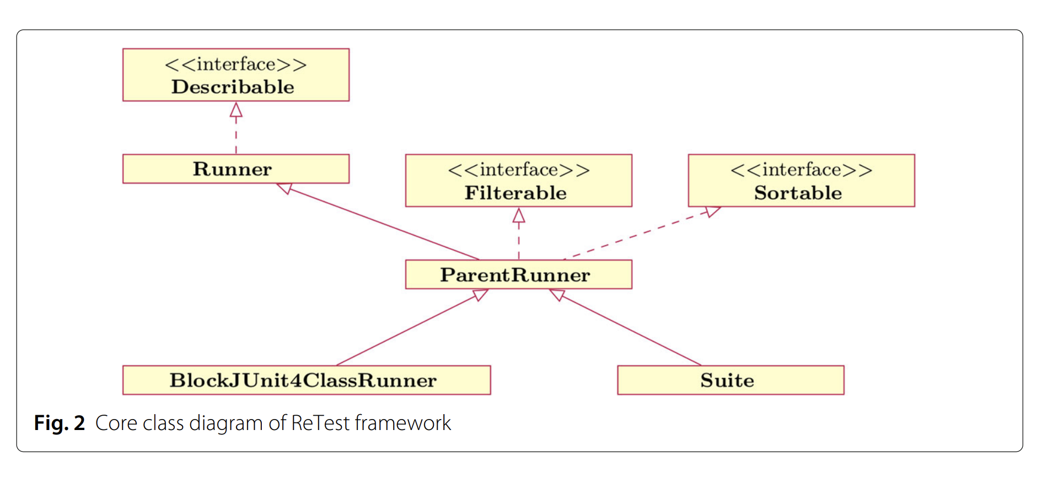
ReTest

Slide 63
JUnit best practices
Naming Conventions
Pass/Fail Patterns
Data driven
Arrange, Act, Assert
Data Transaction Patterns
Collection Management Patterns
Performance Patterns
Process Patterns
Simulation Patterns
Multithreading Patterns
Stress-Test Patterns
Presentation Layer Patterns

Slide 64
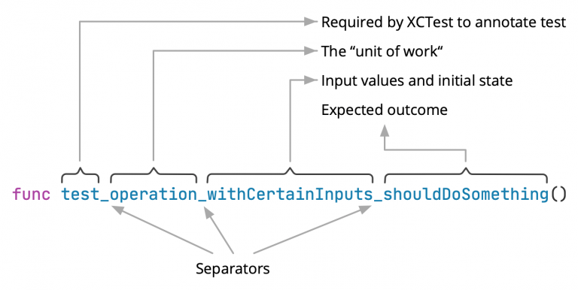
Naming Conventions

Slide 65
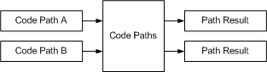
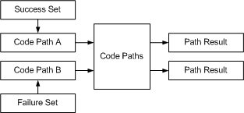
Pass/Fail Patterns

Slide 66
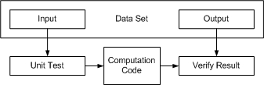
Data driven

Slide 67
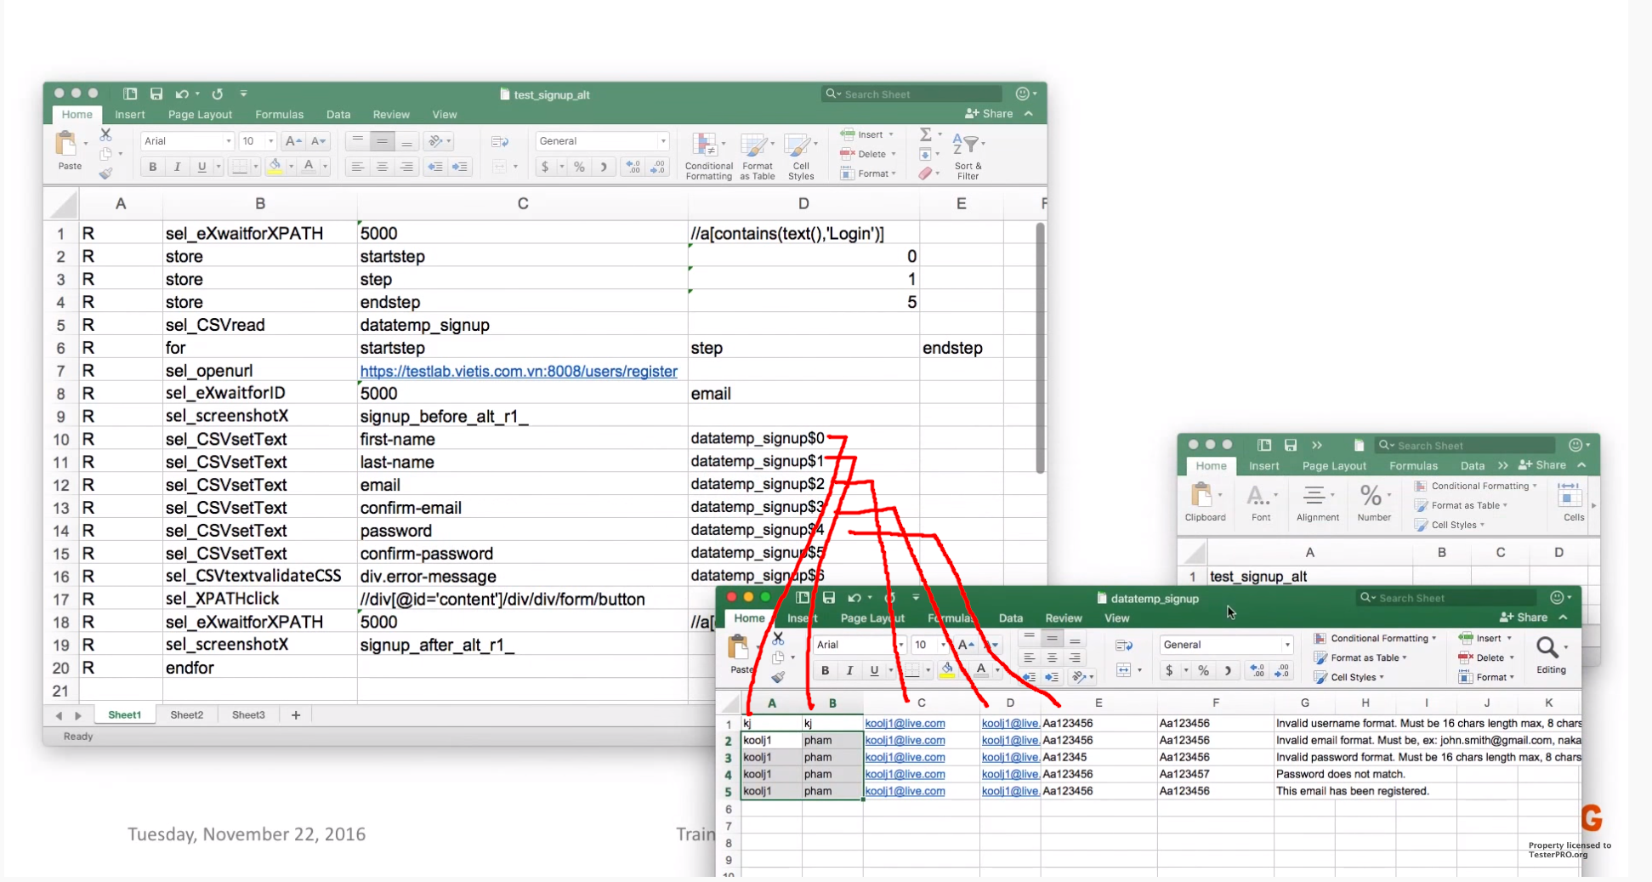

Slide 68
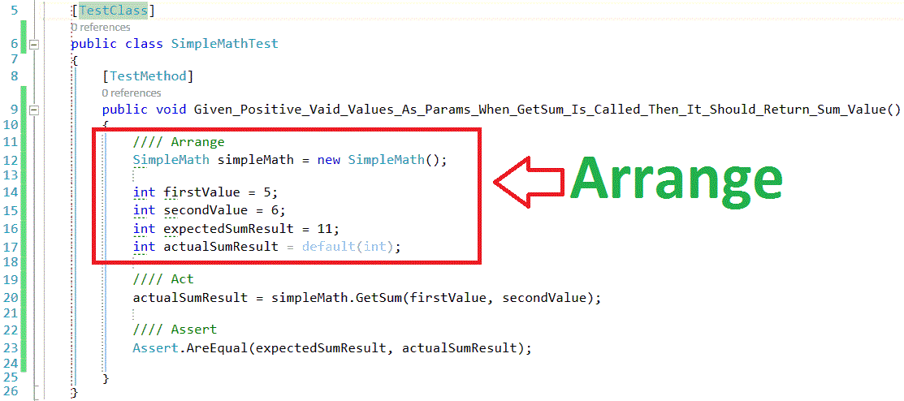
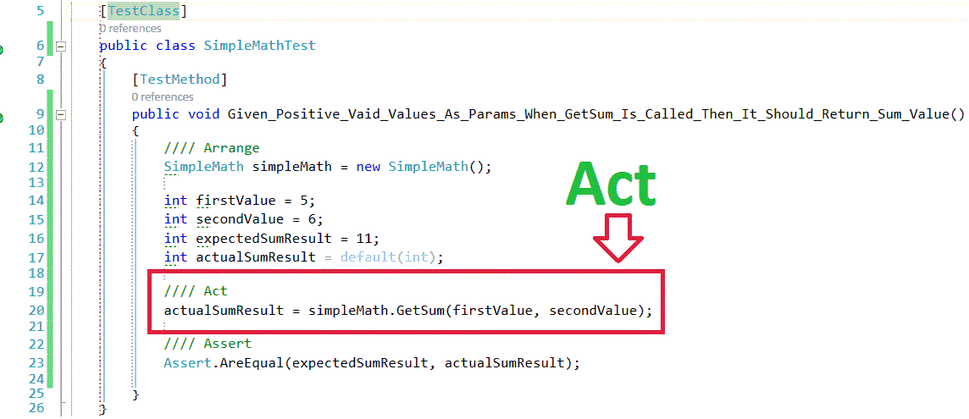
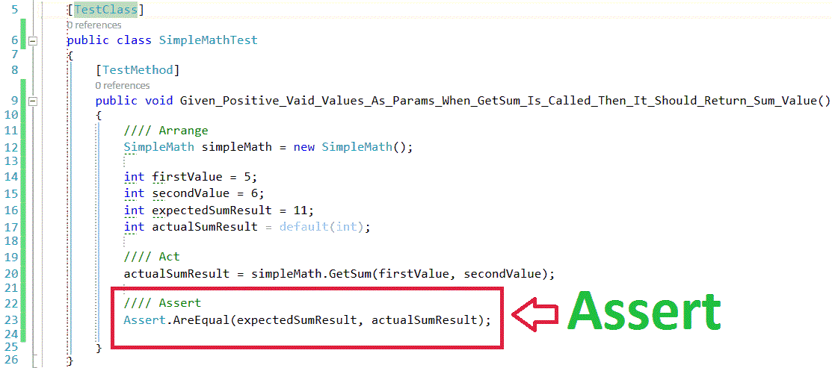
Arrange, Act, Assert

Slide 69
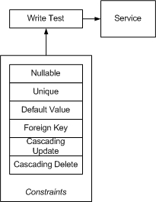
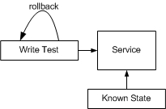
Data Transaction Patterns

Slide 70
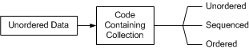
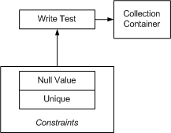
Collection Management Patterns

Slide 71
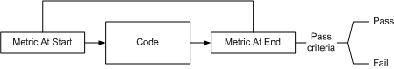
Performance Patterns

Slide 72
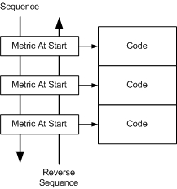
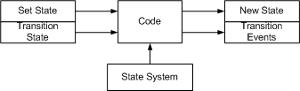
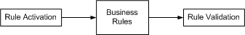
Process Patterns

Slide 73
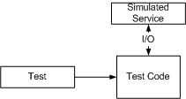
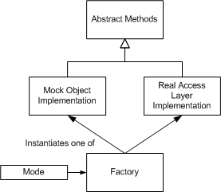

Simulation Patterns

Slide 74


Multithreading Patterns

Slide 75


Stress-Test Patterns

Slide 76

Presentation Layer Patterns

Slide 77

Presentation Layer Patterns

Slide 78


TDD
best
practices

Slide 79
JUnit
Thực hành
Practice: Parameters
Practice: Rules
Rules
Theories
Test Fixtures
Categories
Use with Maven
Upgrade to JUnit5
JUnit 5 = JUnit Platform + JUnit Jupiter + JUnit Vintage
Ref: https://junit.org/junit5/docs/current/user-guide/#writing-tests

Slide 80
Day 2

Slide 81
Agenda
JUnit with rule, parameterized
TDD cycle, best practice

Slide 82
TDD cycle
Quickly add test
Fake It
Obvious Implementation
Triangulation
we only generalize code when we have two examples or more
Run all tests and see the new one fail
Make a little change
Run all tests and see them all succeed
Refactor to remove duplication (p.1)

Slide 83
TDD steps
Say that we need to write code for a task
(Write some code to) setup the environment for the task (e.g., a DB table with some sample data)
This will be the “setUp” part of a test.
Write “tearDown” too
(Write code to) invoke the code for task A
This is the first part (exercise) of “testA”
You get to design the inputs and output of your code
So far you have written some testing code that clarifies in what context will your new feature run

Slide 84
TDD steps cont..
3. Now start writing the code for task A
4. Run the test, put breakpoints in your IDE, clarify the detail design of your code
Keep refining the code until it works in the given scenario
5. Finish the test by writing the assertions part of the test
6. Repeat from step 1 or 2 (another scenario)
TDD fits well with agile development:
Write some code, try it out, learn how to do better
Also comes in handy for refactoring

Slide 85
Simple try !!!

Slide 86
TDD best practices
Red Bar Patterns
Child, mock, self Shunt
Broken test
Geen Bar Patterns:
Fake It ('Til You Make It)
Triangulate
One to Many
xUnit Patterns
Fixture
Exception

Slide 87

Triangulate
How do you most conservatively drive abstraction with tests? Abstract only when you have two or more examples

Slide 88

Fixture
How do you create common objects needed by several tests? Convert the local variables in the tests into instance variables. Override setUp() and initialize those variables.

Slide 89

Exception
How do you test for expected exceptions? Catch expected exceptions and ignore them, failing only if the exception isn't thrown.

Slide 90


Slide 91
Value Object
How do you implement an object whose behavior is the composition of the behavior of a list of
other objects? Make it an Imposter for the component objects.

Slide 92

Template Method
How do you represent the invariant sequence of a computation while providing for future refinement? Write a method that is implemented entirely in terms of other methods.
Input/process/output
Send message/receive reply
Read command/return result

Slide 93

Pluggable Selector
How do you invoke different behavior for different instances? Store the name of a method, and dynamically invoke the method.
What do you do when you have ten subclasses of a class, each implementing only one method?

Slide 94

Imposter
How do you introduce a new variation into a computation? Introduce a new object with the same protocol as an existing object but a different implementation.
No duplication
Null Object - You can treat the absence of data the same as the presence of data
Composite - You can treat a collection of objects the same as a single object.

Slide 95

Composite
How do you implement an object whose behavior is the composition of the behavior of a list of other objects? Make it an Imposter for the component objects.

Slide 96
Refactoring
Migrate Data
Isolate Change
Extract Interface
Inline/Extract Method
Move Method

Slide 97
Kết luận quan trọng #3

Slide 98
Why refactoring
Two loop structures are similar. By making them identical, you can merge them.
Two branches of a conditional are similar. By making them identical, you can eliminate the conditional.
Two methods are similar. By making them identical, you can eliminate one.
Two classes are similar. By making them identical, you can eliminate one.

Slide 99
JUnit5
Nested Tests
Spring Boot
Mockito Extension
Dynamic

Slide 100
JUnit
Thực hành
Practice: Categories
Use with Maven
Multithreaded code and Concurrency
Java contract test helpers
Practice: ATDD, DTDD

Slide 101
Kết luận quan trọng #4

Slide 102
Multithreading Patterns

Slide 103
Day 3

Slide 104
Agenda
Mock best practices
Patterns, anti-patterns

Slide 105
Test pyramid

Slide 106
Mock

Slide 108

Mock http

Slide 109

Stub database

Slide 110
Simulation Patterns

Slide 111

Unmanaged dependencies

Slide 112
Dependencies
Managed dependencies (out-of-process dependencies you have full control over)—These dependencies are only accessible through your application; interactions with them aren’t visible to the external world. A typical example is a database. External systems normally don’t access your database directly; they do that through the API your application provides.
Unmanaged dependencies (out-of-process dependencies you don’t have full control over) Interactions with such dependencies are observable externally. Examples include an SMTP server and a message bus: both produce side effects visible to other applications.

Slide 113


Slide 114

Interactions at edges

Slide 115
Mocks in integration

Slide 116
Verifying the number of calls
The existence of expected calls
The absence of unexpected calls

Slide 117
Mocking only own types
You often don’t have a deep understanding of how the third-party code works.
Even if that code already provides built-in interfaces, it’s risky to mock those interfaces, because you have to be sure the behavior you mock matches what the external library actually does.
Adapters abstract non-essential technical details of the third-party code and define the relationship with the library in your application’s terms.

Slide 118
JUnit
Thực hành
Practice: Refactoring
Practice: Anti-patterns
Superficial Test Coverage
Overly Complex Tests
External Dependencies
Catching Unexpected Exceptions
Mixing Production and Test Code
No Unit Tests
Refer: https://exubero.com/junit/anti-patterns/

Slide 119
Kết luận quan trọng #5

Slide 120
JUnit is designed to work best with a number of small tests. It executes each test within a separate instance of the test class. It reports failure on each test. Shared setup code is most natural when sharing between tests. This is a design decision that permeates JUnit, and when you decide to report multiple failures per test, you begin to fight against JUnit. This is not recommended.

Slide 121
JUnit
Thực hành
Practice: Automation keyword
Create keyword
Call keyword
Autorun
Mockito
Build mock function
Call mock

Slide 122
Kết luận quan trọng #6

Slide 123
Mockito
No Handwriting − No need to write mock objects on your own.
Refactoring Safe − Renaming interface method names or reordering parameters will not break the test code as Mocks are created at runtime.
Return value support − Supports return values.
Exception support − Supports exceptions.
Order check support − Supports check on order of method calls.
Annotation support − Supports creating mocks using annotation.

Slide 124
Tổng kết khi làm automation procedures, keywords
Fast − Automation runs test cases significantly faster than human resources.
Less investment in human resources − Test cases are executed by using automation tool so less tester are required in automation testing.
More reliable − Automation tests perform precisely same operation each time they are run.
Programmable − Testers can program sophisticated tests to bring out hidden information.

Slide 125
Day 4

Slide 126
JUnit
Thực hành
Practice: UT Jprofiler với profiling
checking time execution, cpu, ram
counting called, be-called

Slide 127
TestNG
Thực hành
Practice: Build XML run
Practice: Run multithreads

Slide 128
Kết luận quan trọng #7

Slide 129
TestNG pros, cons
JUnit
JUnit is a simple framework to write repeatable tests. It is an instance of the xUnit architecture for unit testing frameworks.
Cucumber
Cucumber is a tool that supports Behaviour-Driven Development (BDD) - a software development process that aims to enhance software quality and reduce maintenance costs.
Selenium
Selenium automates browsers. That's it! What you do with that power is entirely up to you. Primarily, it is for automating web applications for testing purposes, but is certainly not limited to just that. Boring web-based administration tasks can (and should!) also be automated as well.
Mockito
It is a mocking framework that tastes really good. It lets you write beautiful tests with a clean & simple API. It doesn’t give you hangover because the tests are very readable and they produce clean verification errors.
NUnit
An evolving, open source framework designed for writing and running tests in Microsoft .NET programming languages.It is an aspect of test-driven development , which is part of a larger software design paradigm known as Extreme Programming

Slide 130


Slide 131
Vs JUnit
Support for parameters.
Supports dependent methods testing.
Test configuration flexible.
Supports powerful execution model.
Embeds BeanShell for further flexibility.
TestNG has a more elegant way of handling parameterized tests with the data-provider concept.
For the same test class TestNG support for multiple instances.
Extendibility of using different Tools and plug-ins like Eclipse, Maven, IDEA etc.
Default JDK functions for runtime and logging (no dependencies).
Supported different Annotations like @BeforeSuite, @AfterSuite, @BeforeClass, @AfterClass, @BeforeTest, @AfterTest, @BeforeGroups, @AfterGroups, @BeforeMethod, @AfterMethod, @DataProvider, @Factory, @Listeners, @Parameters, @Test.

Slide 132
END

